Slide 1
Wellness Business Resource Group
Mindfulness as a Tool for Growth
Notes:
Welcome - OLIVIA

Slide 2
Purpose
The purpose of this group is to build a community of women working together to take charge of their health and wellness journey. We encourage you to share your challenges and accomplishments, and exchange ideas and tips for health and well-being. Let’s support and learn from each other and create a wellness connection!
Chats are not recorded as to encourage participation and networking.
These groups are strategically structured to be group conversations.
Notes:
Purpose of the Group - OLIVIA

Slide 3
What is Wellness?
Wellness is a holistic integration of physical, mental, and spiritual well-being, fueling the body, engaging the mind, and nurturing the spirit. Although it always includes striving for health, it’s more about living life fully, and is “a lifestyle and a personalized approach to living life in a way that… allows you to become the best kind of person that your potentials, circumstances, and fate will allow.
Wellness encompasses 8 mutually interdependent dimensions:
Physical
Social
Vocational
Financial
Environmental
Intellectual
Emotional
Spiritual
SOURCE: https://www.ncbi.nlm.nih.gov/pmc/articles/PMC5508938/
Notes:
Overview of the 8 Dimensions of Wellness we introduced in our recent discussion - OLIVIA

Slide 4
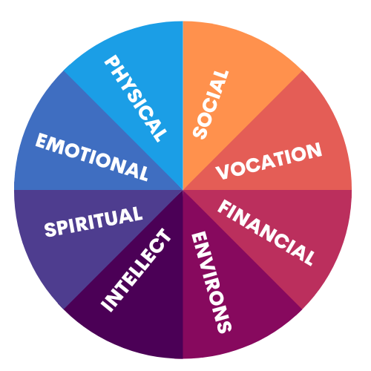
Where Does Mindfulness Fit In?
POLL
How much do you already know?
Mindfulness as a Wellness tool can be used to enhance every dimension.
Notes:
Jen’s Talking Points
Will explain that this is not so much a presentation to teach you about audience, but more of a conversation starter. So will not go into any depth, but welcome questions and conversation
Speak about how Mindfulness is not just about the Emotional or Intellect Dimensions of Wellness, but how Mindfulness helps with every aspect.
Share briefly about my personal experience with Mindfulness, how I found JKZ’s book when I was recovering from cancer, but really committed to Mindfulness as a way of life and got my MBSR during the pandemic. Talk about how being a meditation facilitator has helped me stay committed to my Mindfulness practice.
POLL – Understand the audience How much do you already know about Mindfulness?
I’m a total beginner
I have some familiarity
I have a regular practice
I’m an advanced practitioner

Slide 5
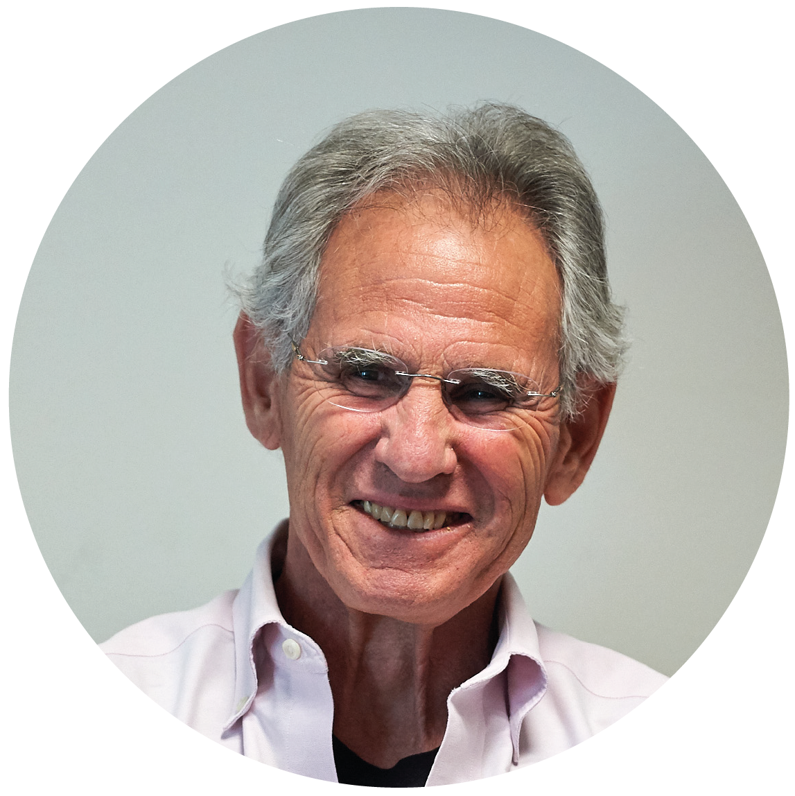
What is Mindfulness?
“Mindfulness is awareness that arises through paying attention, on purpose, in the present moment, non-judgmentally.
And then I sometimes add, in the service of self-understanding and wisdom.”
How would
you define Mindfulness?
Jon Kabat-Zinn
Jon Kabat-Zinn on Mindfulness: https://www.youtube.com/watch?v=HmEo6RI4Wvs
Notes:
Jen – Talking Points
ASK AUDIENCE TO DEFINE MINDFULNESS either by coming off mute or in the chat. After we get some definitions, the definition will slide in from the left (animation)
Mindfulness and Meditation are not necessarily the same, but Meditation is a tool to grow Mindfulness. Meditation is a practice to cultivate mindfulness.
Paying attention on purpose – not so easy when you think about how many things we do on auto-pilot, like driving

Slide 6
How Does Mindfulness Promote Growth?
Improved self-awareness
Increased focus and concentration
Improved relationships
Improved ability to withstand uncertainty
Improved self-control
Increased empathy
POLL
Which is most important to you?
Notes:
Jen – Talking Points
I will table some brief research and examples on each aspect of growth, but the overall message is that the increased self-awareness that Mindfulness fosters improves everything else
Increased focus – Amishi Jha/Peak Mind
Better relationships – Jen Fisher/Deloitte
Tolerate uncertainty – Washington Post article: https://www.washingtonpost.com/wellness/2023/01/23/mindfulness-meditation-anxiety-medication/
Improve relationships – Berkely Center for the Greater Good: https://greatergood.berkeley.edu/article/item/How_does_mindfulness_help_control_behavior
Increased empathy + Self compassion – NIH study: https://www.ncbi.nlm.nih.gov/pmc/articles/PMC7139462/

Slide 7
Questions & Discussion
What was your understanding of Mindfulness before this presentation? Do you have questions?
What are your barriers to beginning a Mindfulness Meditation practice?
Do you already have a Mindfulness practice? Can you share how it has helped you?
What can you reasonably commit to consistently?
Notes:
Olivia & Jen – Open the discussion to participants. If there are more than 30 attendees, do breakout rooms of five.
POLL: Would you be interested in a monthly Mindfulness Meeting?
Yes
No
How do you practice work/life balance boundaries when you work in social media where that space doesn't necessarily have an off button?
Tips on quieting your brain when meditating. I always struggle with this
How can we start a mindfulness practice if we are currently in a state of overwhelm?

Slide 8
You can’t stop the waves,
but you can learn to surf.
~John Kabat-Zinn
Notes:
End of Discussion – OLIVIA
Tell people they can stay for the optional meditation
Presentation will be loaded into group chat with Resources slide

Slide 9
Five-Minute Mindfulness Meditation
Focus on your breath in one of these ways:
Focus on how your breath feels on your upper lip as you inhale and exhale
Focus on your chest rising and falling with each inhale and exhale
Focus on the rise and fall of your abdomen as you breath
Notes:
Meditation – JEN will lead

Slide 10
Resources
Beginner Reading
Full-Catastrophe Living by Jon Kabat-Zinn
Mindfulness for Beginners by Jon Kabat-Zinn, 2006
Zen Mind, Beginner's Mind by Shunryū Suzuki, 1970
Mindfulness at Work
Peak Mind by Amishi Jha
Mindfulness Without the Bells & Beads by Clif Smith
Free Online Meditation
Garrison Institute Noontime Meditation Group: https://www.garrisoninstitute.org/noontime-meditation-group/
Tibet House: https://thus.org/programs-and-events/meditation-classes/r
Low-Cost Meditation
Meditate Together with Mindful Leader: https://www.mindfulleader.org/meditate-together
Publications
Mindful: https://www.mindful.org/magazine/
Tricycle: https://tricycle.org/ (Buddhist)

